Slide 1
LESSON 17

Slide 2
Overview
of
Previous Lesson(s)

Slide 3
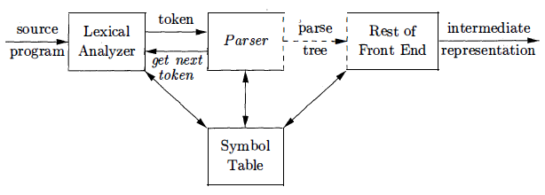
Over View
In our compiler model, the parser obtains a string of tokens from the lexical analyzer & verifies that the string of token names can be generated by the grammar for the source language.

Slide 4
Over View..
The syntax of programming language constructs can be specified by CFG.
A grammar gives a precise syntactic specification of a programming language.
Universal parsing methods can parse any grammar. These methods are, however, too inefficient to use in production compilers.

Slide 5
Over View..
The commonly used parsing methods in compilers is either top-down or bottom-up.
Top-down methods build parse trees from the top (root) to the bottom (leaves), while bottom-up methods start from the leaves and work their way up to the root.

Slide 6
Over View...
Programming errors can occur at many different levels & can be categorized as:
Lexical errors include misspellings of identifiers, keywords, or operators - e.g., the use of an identifier elipseSize instead of ellipseSize – and missing quotes around text intended as a string.
Semantic errors include type mismatches between operators and operands. An example is a return statement in a Java method with result type void.

Slide 7
Over View..
Syntactic errors include misplaced semicolons or extra or missing braces, that is, "{" or "}" As another example, in C or Java, the appearance of a case statement without an enclosing switch is a syntactic error.
Logical errors can be anything from incorrect reasoning on the part of the programmer to the use in a C program of the assignment operator = instead of the comparison operator ==.

Slide 8
Over View...
The error handler in a parser has goals that are simple to state but challenging to realize:
Report the presence of errors clearly and accurately.
Recover from each error quickly enough to detect subsequent errors.
Add minimal overhead to the processing of correct programs.

Slide 9
Over View...
Trivial Approach: No Recovery
Print an error message when parsing cannot continue and then terminate parsing.
Panic-Mode Recovery
The parser discards input until it encounters a synchronizing token.
Phrase-Level Recovery
Locally replace some prefix of the remaining input by some string. Simple cases are exchanging ; with , and = with ==.
Error Productions
Include productions for common errors.
Global Correction
Change the input I to the closest correct input I' and produce the parse tree for I'.

Slide 10
Over View...
Grammars used to systematically describe the syntax of programming language constructs like expressions and statements.
stmt --> if ( expr ) stmt else stmt
A syntactic variable stmt is used to denote statements and variable expr to denote expressions.
Other productions then define precisely what an expr is and what else a stmt can be.
A language generated by a grammar is called a context free language

Slide 11
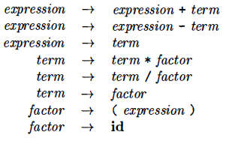
Over View...
Grammar
Terminals: id + - * / ( )
Non-Terminals: expression, term, factor
Start Symbol: expression

Slide 12
TODAY’S LESSON

Slide 13
Contents
Context-Free Grammars
Formal Definition of a CFG
Notational Conventions
Derivations
Parse Trees and Derivations
Ambiguity
Verifying the Language Generated by a Grammar
Context-Free Grammars Vs Regular Expressions
Writing a Grammar
Lexical Vs Syntactic Analysis
Eliminating Ambiguity
Elimination of Left Recursion

Slide 14
Parse Tree & Derivations
A parse tree is a graphical representation of a derivation that filters out the order in which productions are applied to replace non-terminals .
Each interior node of a parse tree represents the application of a production.
The interior node is labeled with the non-terminal A in the head of the production.
The children of the node are labeled, from left to right, by the symbols in the body of the production by which this A was replaced during the derivation.

Slide 15
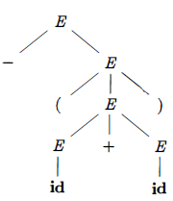
Parse Tree & Derivations..
Ex: -(id + id)
The leaves of a parse tree are labeled by non-terminals or terminals and, read from left to right constitute a sentential form, called the yield or frontier of the tree.

Slide 16
Parse Tree & Derivations…
A derivation starting with a single non-terminal, A ⇒ α₁ ⇒ α₂ ... ⇒ α_{n}
It is easy to write a parse tree with A as the root and α_{n} as the leaves.
The LHS of each production is a non-terminal in the frontier of the current tree so replace it with the RHS to get the next tree.
There can be many derivations that wind up with the same final tree.
But for any parse tree there is a unique leftmost derivation the produces that tree.
Similarly, there is a unique rightmost derivation that produces the tree.

Slide 17
Ambiguity
A grammar that produces more than one parse tree for some sentence is said to be ambiguous.
Alternatively, an ambiguous grammar is one that produces more than one leftmost derivation or more than one rightmost derivation for the same sentence.
Ex Grammar E → E + E | E * E | ( E ) | id
It is ambiguous because we have seen two parse trees for id + id * id

Slide 18
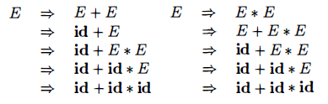
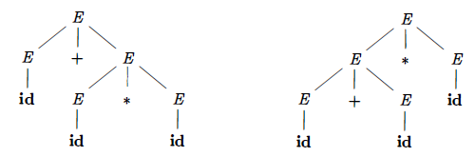
Ambiguity..
There must be at least two leftmost derivations.
So two parse trees are

Slide 19
Language Verification
A proof that a grammar G generates a language L has two parts:
Show that every string generated by G is in L
Show that every string in L can indeed be generated by G.
Ex Grammar S → ( S ) S | ɛ
Apparently this simple grammar generates all strings of balanced parentheses, and only such strings.

Slide 20
Language Verification..
To show that every sentence derivable from S is balanced, we use an inductive proof on the number of steps n in a derivation.
BASIS:
The basis is n = 1 The only string of terminals derivable from S in one step is the empty string, which surely is balanced.
INDUCTION:
Now assume that all derivations of fewer than n steps produce balanced sentences, and consider a leftmost derivation of exactly n steps.

Slide 21

Language Verification...
Such a derivation must be of the form
The derivations of x and y from S take fewer than n steps, so by the inductive hypothesis x and y are balanced. Therefore, the string (x)y must be balanced.
That is, it has an equal number of left and right parentheses, and every prefix has at least as many left parentheses as right.

Slide 22
Language Verification...
Now we show that every balanced string is derivable from S
To do so, we use induction on the length of a string.
BASIS:
If the string is of length 0, it must be ɛ, which is balanced.
INDUCTION:
First, observe that every balanced string has even length.
Assume that every balanced string of length less than 2n is derivable from S.
Consider a balanced string w of length 2n, n ≥ 1

Slide 23

Language Verification...
Surely w begins with a left parenthesis. Let (x) be the shortest nonempty prefix of w having an equal number of left and right parentheses.
Then w can be written as w = (x)y where both x and y are balanced.
Since x and y are of length less than 2n, they are derivable from S by the inductive hypothesis.
Thus, we can find a following derivation proving that w = (x)y is also derivable from S

Slide 24

CFG Vs RE
Every construct that can be described by a regular expression can be described by a grammar, but not vice-versa.
Alternatively, every regular language is a context-free language, but not vice-versa.
Consider RE (a|b)* abb & the grammar
We can construct mechanically a grammar to recognize the same language as a nondeterministic finite automaton (NFA).

Slide 25
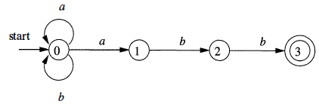
CFG Vs RE..
The defined grammar above was constructed from the NFA using the following construction
For each state i of the NFA, create a non-terminal A_{i} .
If state i has a transition to state j on input a add the production A_{i} → a Aj If state i goes to state j on input ɛ add the production A_{i} → Aj
If i is an accepting state, add A_{i} → ɛ
If i is the start state, make A_{i} be the start symbol of the grammar.

Slide 26
Lexical Vs Syntactic Analysis
Why use regular expressions to define the lexical syntax of a language?
Reasons:
Separating the syntactic structure of a language into lexical and non-lexical parts provides a convenient way of modularizing the front end of a compiler into two manageable-sized components.
The lexical rules of a language are frequently quite simple, and to describe them we do not need a notation as powerful as grammars.

Slide 27
Lexical Vs Syntactic Analysis..
Regular expressions generally provide a more concise and easier-to-understand notation for tokens than grammars.
More efficient lexical analyzers can be constructed automatically from regular expressions than from arbitrary grammars.
Regular expressions are most useful for describing the structure of constructs such as identifiers, constants, keywords, and white space

Slide 28
Lexical Vs Syntactic Analysis..
Grammars, on the other hand, are most useful for describing nested structures such as balanced parentheses, matching begin-end's, corresponding if-then-else's, and so on.
These nested structures cannot be described by regular expressions.

Slide 29

Eliminating Ambiguity
An ambiguous grammar can be rewritten to eliminate the ambiguity.
Ex. Eliminating the ambiguity from the following dangling-else grammar:
Compound conditional statement
if E₁ then S₁ else if E₂ then S₂ else S₃

Slide 30
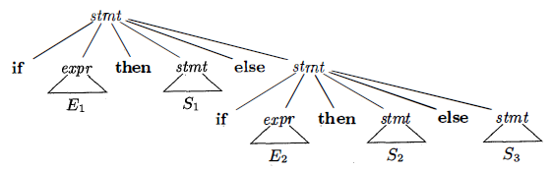
Eliminating Ambiguity..
Parse tree for this compound conditional statement:
This Grammar is ambiguous since the following string has the two parse trees:
if E₁ then if E₂ then S₁ else S₂

Slide 31
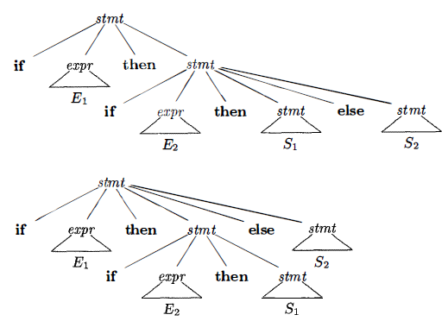
Eliminating Ambiguity…

Slide 32
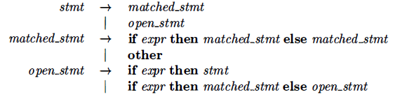
Eliminating Ambiguity…
We can rewrite the dangling-else grammar with the idea:
A statement appearing between a then and an else must be matched that is, the interior statement must not end with an unmatched or open then.
A matched statement is either an if-then-else statement containing no open statements or it is any other kind of unconditional statement.

Slide 33
Thank You

